Slide 1
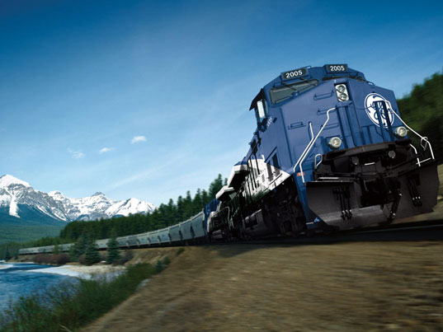
Railroad Block Signal
Railroad Block Signal Software Tool
Team Members:
Kenneth Truex
Chad Mason
Zachary McHenry
Christopher Diebold

Slide 2
Previous Goals
Task | Completion % | Kenneth Truex | Christopher Diebold | Chad Mason | Zachary McHenry | To Do
Create the user forms | 70% |  |  | 70% |  | Implement GE’s UI Template
Finish the algorithms | 90% | 90% |  |  |  | Finish implementing exception handling
Query the database | 100% |  | 100%
Look into multithreading | 85% |  |  | 30% |  | Implement Semaphore
Implement Excel Parser | 100% |  |  |  | 100%

Slide 3
Milestone 3 Accomplishment Summary

Slide 4
Create the User Forms
Take UI design and alter it to resemble the UI design template provided to us by GE.
Upon initial review, our demo design was a very close match to what GE had in its examples.
We are 70% done with the alterations of the portions that were not a match.

Slide 5
Finish the Algorithms
Added exception handling statement to ensure the function will never return a negative value
Ensure that the function returns the correct value to the Track Layout class to be stored in the object

Slide 6
Query the Database
Finished implementing and testing the insert, remove, update, and find functions for track and track segments objects
Tested these functions by querying the database using MySQL Workbench and then querying in code and manually verifying the results. I tested valid and invalid data ensuring that all exception handling was working correctly.
With the backend being mostly finished I will be moving to a testing role in the future.

Slide 7
Look into Multithreading
We currently have the Excel parsing occurring in a separate thread so as not to stop the entire program while waiting for the parser to finish.
We are 85% complete because we still need to implement a Semaphore in order to prevent a user from trying to access the data before it is finished being parsed.

Slide 8
Implement Excel Parser
GE instructed us to only concern ourselves with receiving an Excel file as input to the tool.
What we agreed upon was that the Excel file would be sent to an implemented parser that extracts the relevant information and stores it directly in the database.

Slide 9
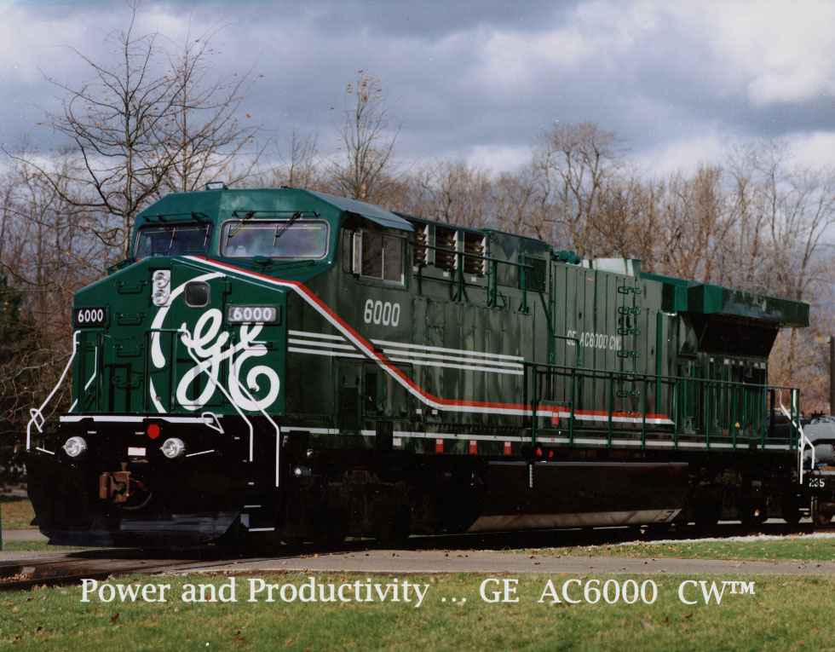
Next Milestone

Slide 10
Milestone 3.5

Slide 11
Milestone 3.5 Role Distribution
Task | Kenneth Truex | Christopher Diebold | Chad Mason | Zachary McHenry
Finish UI |  |  | 75%
Testing |  | 75% |  | 75%
Prepare for Demo | 75%
Summer Goals | 25% | 25% | 25% | 25%

Slide 12
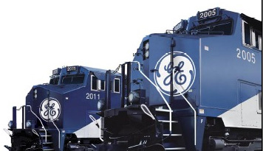
Any Questions?

